Slide 1
Term project presentation (Korean SAT-English part topic modeling)
소프트웨어학부 20186663
전찬웅(team leader)

Slide 2
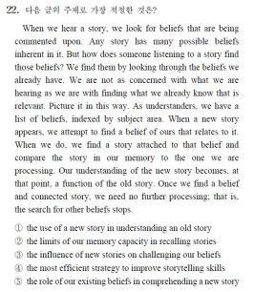
Title
The subject of the project is to guess the correct answer to the English topic(Korean SAT topic problems).
To guess topic/answer

Slide 3
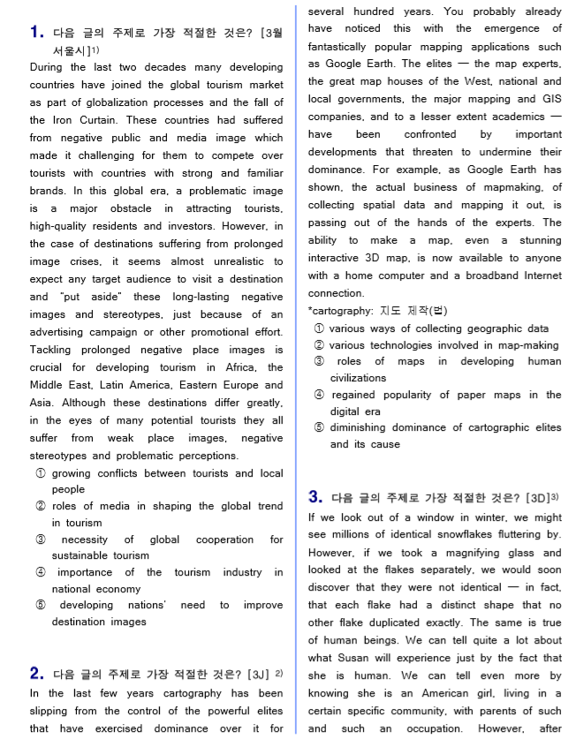
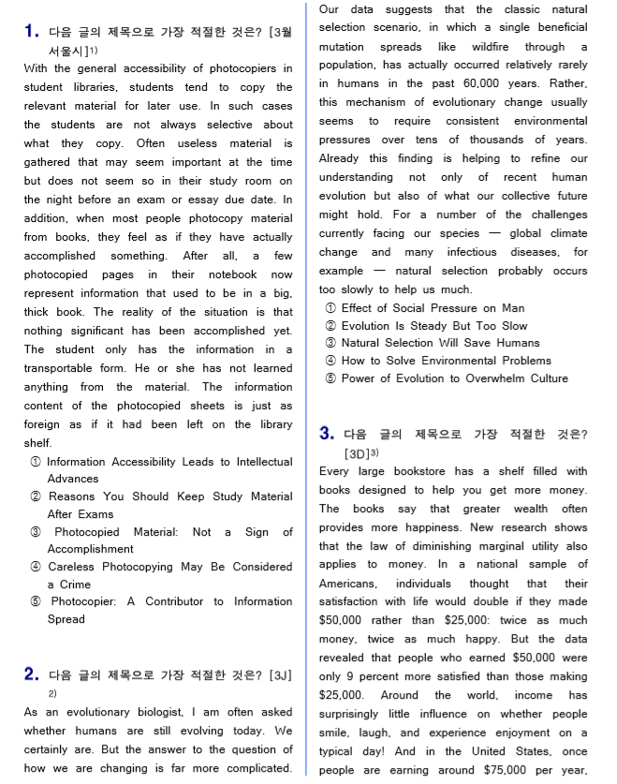
Data
I used title, subject problems in Korea English SAT
Subject problem
Title problem

Slide 4

Data preprocessing
I used title, subject problems in Korea English SAT
1. first all, I processed .pdf data to .txt data
.pdf data
.txt data

Slide 5
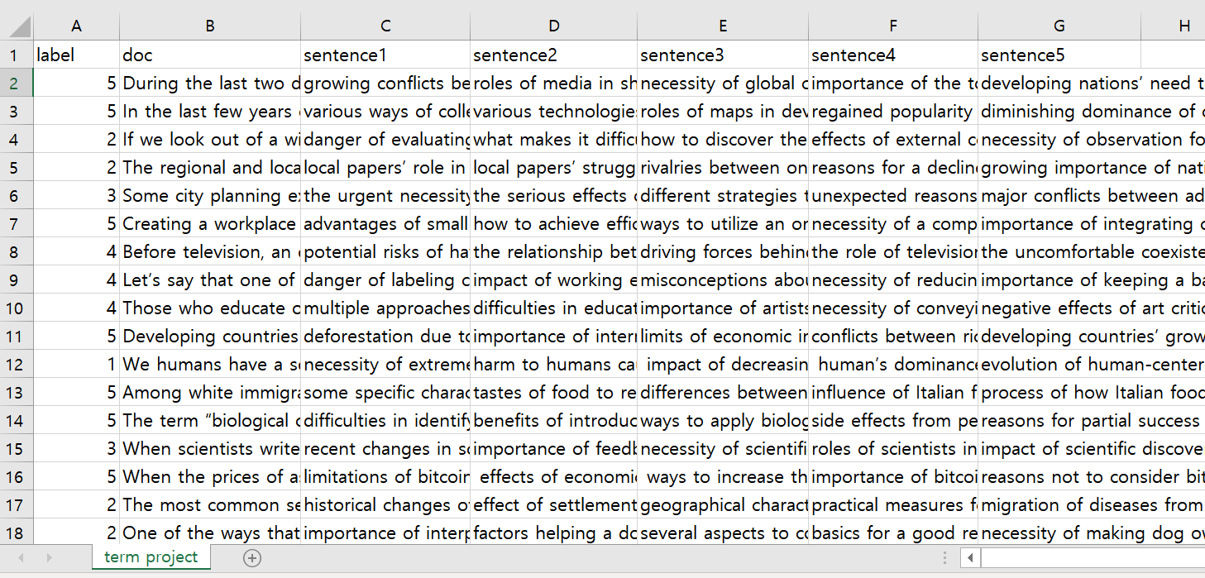
Data preprocessing
I used title, subject problems in Korea English SAT
2. And then, I processed .txt data to .csv data
.txt data
.csv data

Slide 6
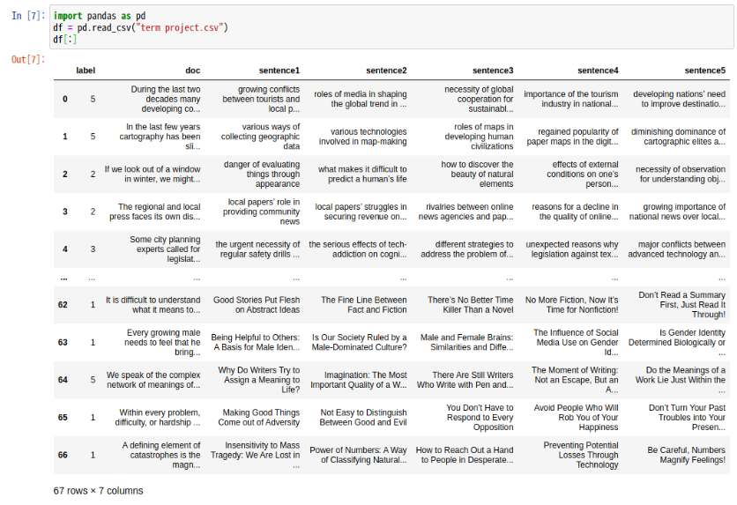
Data preprocessing
I used title, subject problems in Korea English SAT
3. Finally, I used .csv data in pandas for data analysis
.csv data
Data by pandas

Slide 7
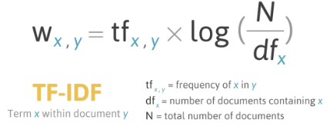
Vectorization
I used Count Vectorization and TF-IDF Vectorization
Count Vectorizer : Simply create a vector with the frequency of words used.
TF IDF Vectorizer : Weight is given by comparing the number of words used in the document with the number of words used in the entire document.

Slide 8
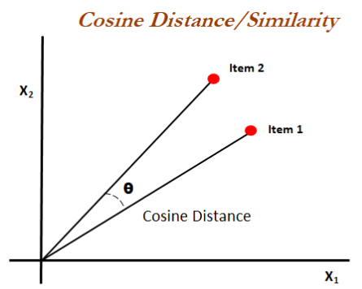
Cosine Similarity
I used cosine similarity to measure the similarity between two vectorized documents.

Slide 9
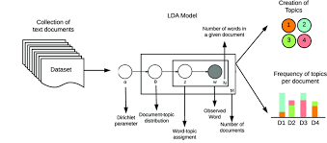
Latent Dirichlet Allocation
Latent Dirichlet allocation(LDA) is one of the probabilistic topic model techniques for describing what topics exist in each document for a given document.
In this project, I used LDA to extract words related to the topic.

Slide 10
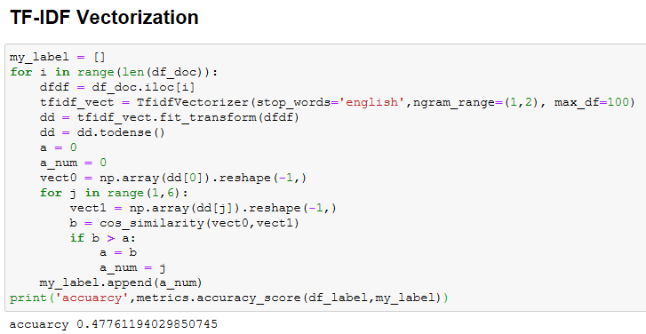
TF-IDF Vectorization
TF-IDF Vectorizer → cosine similarity
vectorizer
Cosine similarity
accuracy

Slide 11
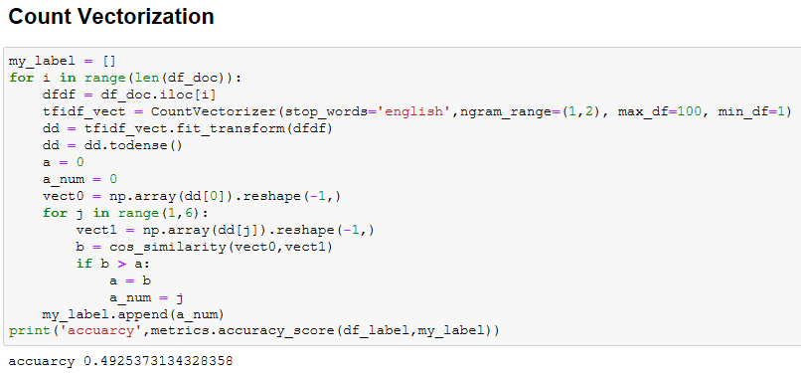
Count Vectorization
Count Vectorizer → cosine similarity
vectorizer
Cosine similarity
accuracy

Slide 12
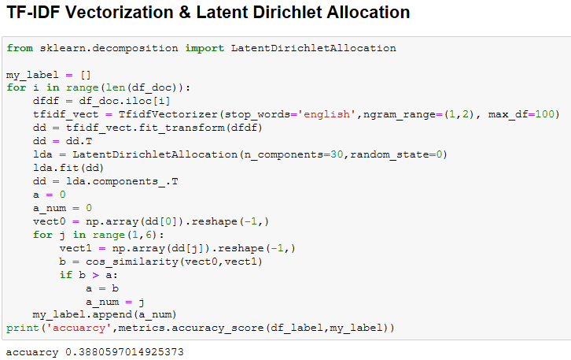
TF-IDF Vectorization & LDA
TF-IDF Vectorizer → LDA → cosine similarity
vectorizer
LDA
Cosine similarity
accuracy

Slide 13
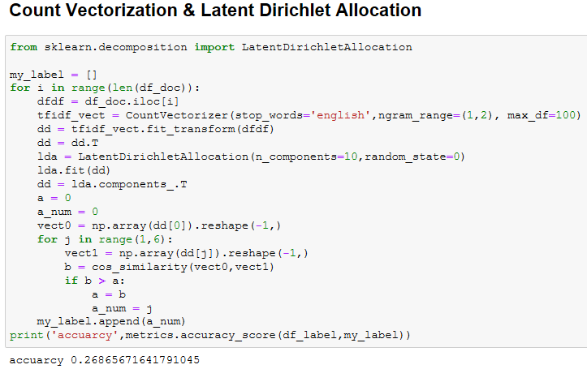
Count Vectorization & LDA
Count Vectorizer → LDA → cosine similarity
vectorizer
LDA
Cosine similarity
accuracy

Slide 14
Conclusion
If using this programming, we can get about 50 points in the English test.
It was difficult to find a meaningful one in each sentence because the amount of each sentence was too small length compared to the document. Therefore, the value of count vectorization, which simply vectorizes into the number of words, came out the highest.
In short sentences, the meaning of the sentence being LDA was difficult to find, so the process of LDA was hindered.

Slide 15
Thanks

